Slide 1

Android Lesson 2: Saving data with Shared Preference
By: Josh Chang
Notes:
Introduce yourself
Ask who has experience

Slide 2
Methods To Store Data
SharedPreference – Key-Value mapping that saves data in your phone
Files – Saves your data in an xml file on your phone
SQLite – Uses Android’s SQLite implementation, saves on your phone
Online Servers – Sends a server your data for it to save and for you to retrieve
Note: Normally, users won’t be able to access the first 3, but if they root their phone, they will gain access to everything.
For app that needs to have sensitive data, use a server.

Slide 3
Lesson’s Goal
Goal – A simple cookie clicker app that will save our progress.
What we need:
TextView to display the text
Button to let users increase our score

Slide 4
Creating Our Initial App

Slide 5
Doing What We Learned
Create a new project called: Cookie Clicker
API 16
Choose: Empty Activity
Leave the Activity and Layout name default

Slide 6
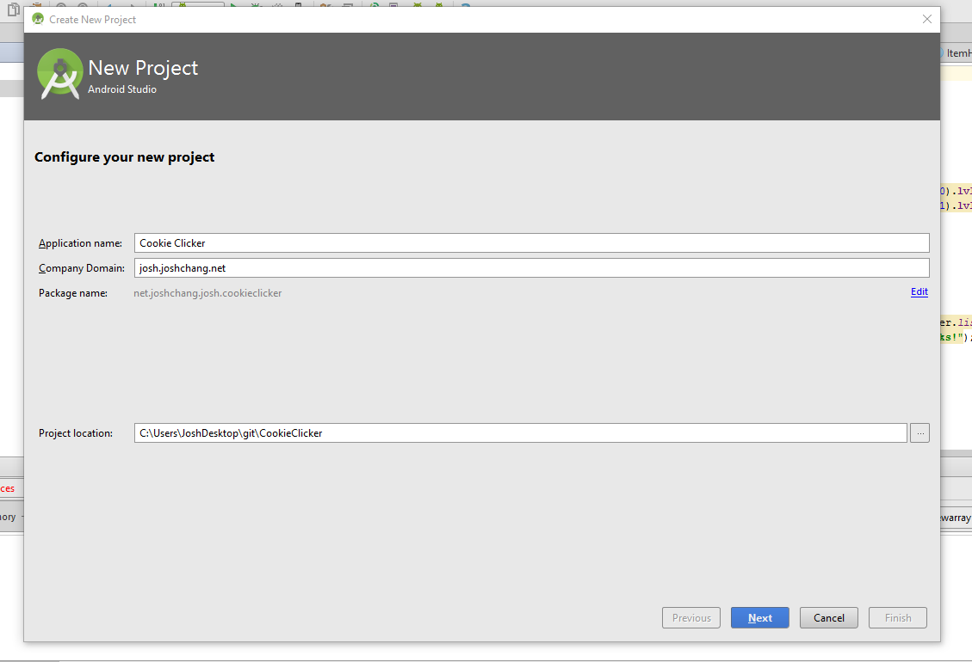
New Project

Slide 7
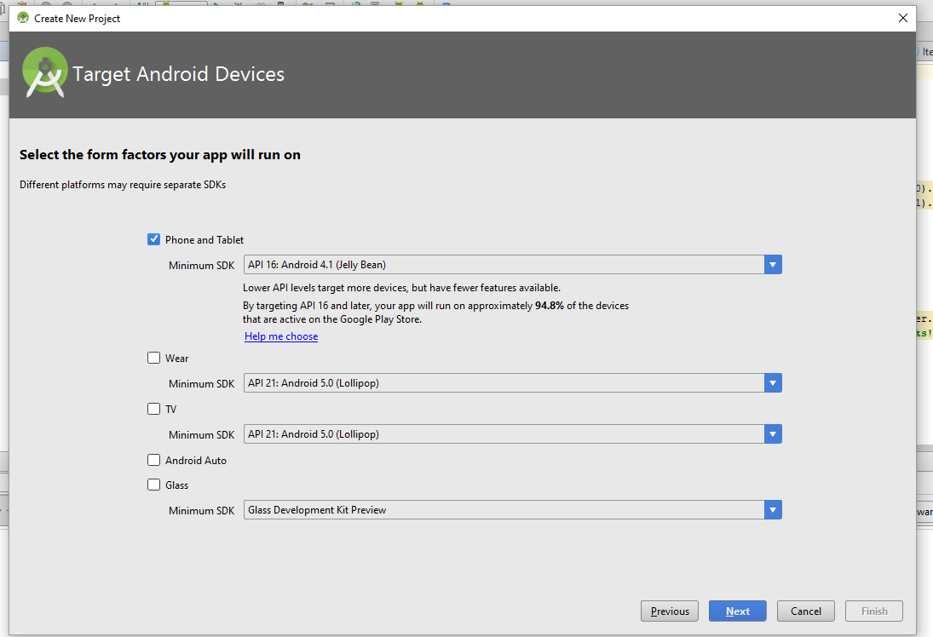
API Selection

Slide 8
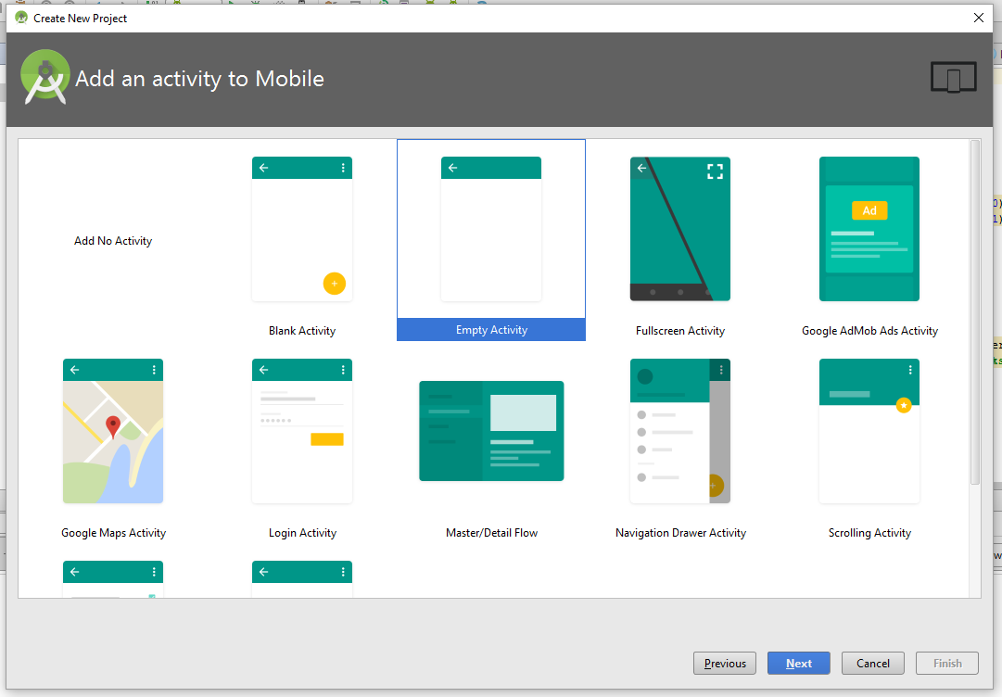
Starting Activity

Slide 9
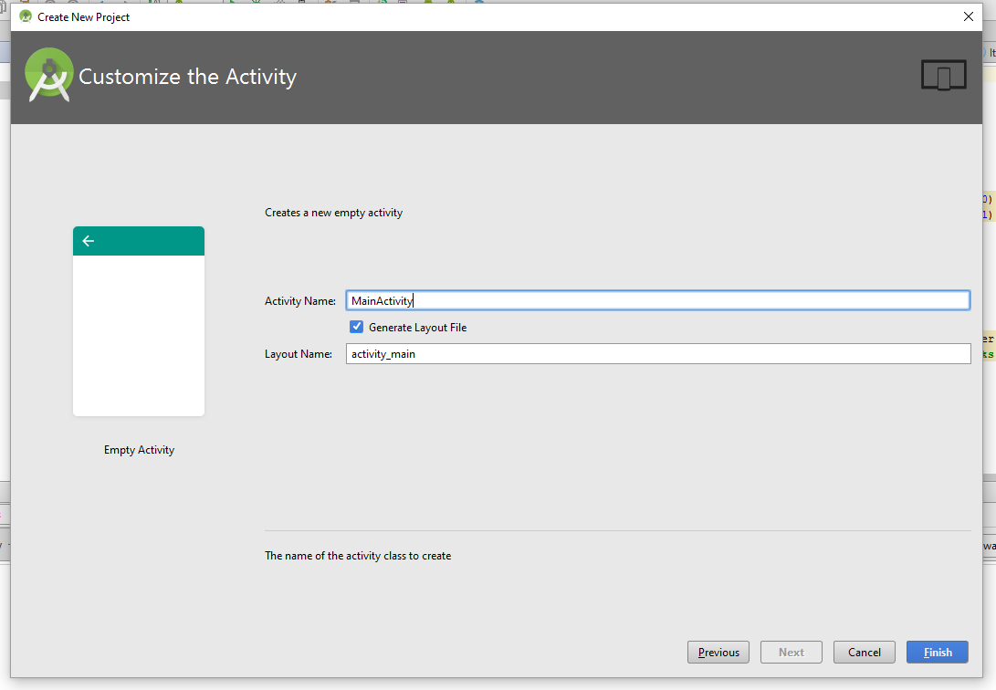
Activity Name

Slide 10
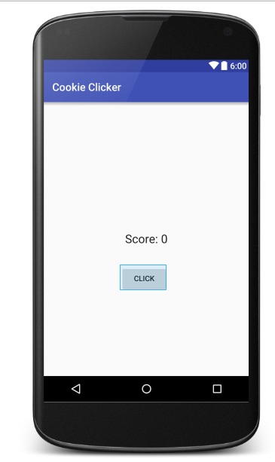
Writing in Activity_main.xml
<?xml version="1.0" encoding="utf-8"?> <RelativeLayout xmlns:android="http://schemas.android.com/apk/res/android" xmlns:tools="http://schemas.android.com/tools" android:layout_width="match_parent" android:layout_height="match_parent" android:paddingBottom="@dimen/activity_vertical_margin" android:paddingLeft="@dimen/activity_horizontal_margin" android:paddingRight="@dimen/activity_horizontal_margin" android:paddingTop="@dimen/activity_vertical_margin" tools:context="net.joshchang.josh.cookieclicker.MainActivity"> <TextView android:layout_width="wrap_content" android:layout_height="wrap_content" android:textAppearance="?android:attr/textAppearanceLarge" android:text="Points: 0" android:id="@+id/tvPoints" android:layout_alignParentTop="true" android:layout_centerHorizontal="true" android:layout_marginTop="101dp" /> <Button android:layout_width="wrap_content" android:layout_height="wrap_content" android:text="Click" android:id="@+id/btnPoints" android:onClick="btnClick" android:layout_centerVertical="true" android:layout_centerHorizontal="true" /> </RelativeLayout>
Nothing new from the previous lesson

Slide 11
MainActivity.java
package net.joshchang.josh.cookieclicker; import android.content.Context; import android.content.SharedPreferences; import android.os.Bundle; import android.support.v7.app.AppCompatActivity; import android.view.View; import android.widget.Button; import android.widget.TextView; public class MainActivity extends AppCompatActivity { private TextView tvPoints; private Button btn; private int points; private SharedPreferences pref; // Hard-coded values to prevent confusion with variable types private final String PREF_NAME = "pref"; private final String POINTS = "totalPoints"; @Override protected void onCreate(Bundle savedInstanceState) { super.onCreate(savedInstanceState); setContentView(R.layout.activity_main); // Basic setup tvPoints = (TextView) findViewById(R.id.tvPoints); btn = (Button) findViewById(R.id.btnPoints); // Restoring data with pref pref = getSharedPreferences(PREF_NAME, Context.MODE_PRIVATE); // Get the points that we store in the pref. Otherwise the default value points = pref.getInt(POINTS, 0); // Sets the text tvPoints.setText("Score: " + points); } // Increment our points and displays it public void btnClick(View v) { points++; tvPoints.setText("Points: " + points); } }

Slide 12
Looks fine? What’s the problem
Run the app, click the button a couple of times, and then close it.
What happens? You lose all progress!

Slide 13
SharedPreference to the Rescue!

Slide 14
What is SharedPreference
It’s Basically a Key-Value Table that saves and reads your data
The data can be any primative type (int, boolean, double, float, etc)

Slide 15
Getting Data From SharedPreference
How to Retrieve data
SharedPreference prefs = getSharedPreference(“pref name”, MODE_PRIVATE);
getSharedPreference is a method that comes with the Activity class that we extended
String text = pref.getString(“key”, “default value on fail”)
Returns the value that was saved to the key, otherwise a default value

Slide 16
SharedPreference How To Save Data
Create a mapping of data from a Key to a Value that you can access anytime in your app
How to add:
SharedPreference.Editor editor = getSharedPreference(“pref name”, MODE_PRIVATE).edit();
Or just pref.edit();
editor.putString(“key”, “value”);
Adds your value to your specific key, you can’t have multiple entry to a key. Include putInt, putBoolean, and more types
editor.commit();
Saves what you put into your SharedPreference

Slide 17
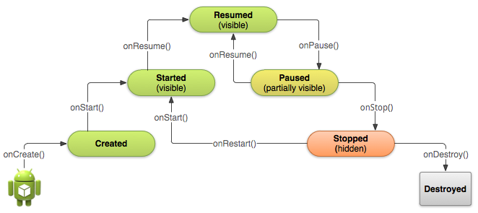
Save Data In onPause()
onPause() is always called when you close your app!

Slide 18
Load Data In onCreate() or onResume()
onCreate() is always called when you first open your app
onResume() will always be called when your app opens

Slide 19
Updated MainActivity.java
package net.joshchang.josh.cookieclicker; import android.content.Context; import android.content.SharedPreferences; import android.os.Bundle; import android.support.v7.app.AppCompatActivity; import android.view.View; import android.widget.Button; import android.widget.TextView; public class MainActivity extends AppCompatActivity { private TextView tvPoints; private Button btn; private int points; private SharedPreferences pref; // Hard-coded values to prevent confusion with variable types private final String PREF_NAME = "pref"; private final String POINTS = "totalPoints"; @Override protected void onCreate(Bundle savedInstanceState) { super.onCreate(savedInstanceState); setContentView(R.layout.activity_main); // Basic setup tvPoints = (TextView) findViewById(R.id.tvPoints); btn = (Button) findViewById(R.id.btnPoints); // Restoring data with pref pref = getSharedPreferences(PREF_NAME, Context.MODE_PRIVATE); // Get the points that we store in the pref. Otherwise the default value points = pref.getInt(POINTS, 0); // Sets the text tvPoints.setText("Score: " + points); } // Increment our points and displays it public void btnClick(View v) { points++; tvPoints.setText("Points: " + points); } // Whenever the app is paused we would save our points @Override protected void onPause() { super.onPause(); // Gets a Editor from our shared preference SharedPreferences.Editor edit = pref.edit(); // Add our points with our editor to be saved edit.putInt(POINTS, points); // Save our changes edit.commit(); } }

Slide 20
That’s all for Shared Preferences!

